Slide 1
American Literature
Realism and Naturalism
(1850-1914)
Realism, n. The art of depicting nature as it is seen by toads. The charm suffusing a landscape painted by a mole, or a story written by a measuring-worm. --Ambrose Bierce The Devil's Dictionary (1911)

Slide 2
Literary Movements
The writing of this period steered away from the Romantic, highly imaginative fiction from the early 1800s.
The main movements are known as:
  Realism
  Naturalism
  Regionalism
π

Slide 3
Realism
literary movement that developed towards the end of the Civil War and stressed the actual (reality) as opposed to the imagined or fanciful

Slide 4
Realism in American Literature
The purpose of the writing is “to instruct and entertain”
Character is more important than plot.
Subject matter is drawn from real life experience.
The realists reject symbolism and romanticizing of subjects.
Settings are usually those familiar to the author.
Plots emphasized “the norm of daily experience”
Ordinary characters

Slide 5
Realism - Characteristics
objective writing about ordinary characters in ordinary situations; “real life”
Character is more important than action and plot; complex ethical choices are often the subject.
Characters appear in their real complexity of temperament and motive; they are in reasonable relation to nature, to each other, to their social class, to their own past.

Slide 6
Realism - Characteristics
Class is important; the novel has traditionally served the interests and aspirations of an insurgent middle class.
Diction is natural vernacular, not heightened or poetic; tone may be comic, satiric, or matter-of-fact.

Slide 7
Why did this literary movement come about?
A reaction against Romanticism
  rejected heroic, adventurous, or unfamiliar subjects
The harsh reality of frontier life and the Civil War shattered the nation’s idealism

Slide 8
Romance and Realism: Taste and Class
Romance
Aspired to the ideal
Thought to be more genteel since it did not show the vulgar details of life
Realism
Thought to be more democratic
Critics stressed the potential for vulgarity and its emphasis on the commonplace
Potential “poison” for the pure of mind
Notes:
A common complaint is that realistic works forced readers into proximity with people whom they would never invite for dinner.

Slide 9
Romanticism vs. Realism
“The trapper was placed on a rude seat which had been made with studied care…His body was placed so as to let the light of the setting sun fall full upon the solemn features. His head was bare, the long thin locks of gray fluttering lightly in the evening breeze. ”
He was most fifty and he looked it. His hair was long and tangled and greasy, and you could see his eyes shining through…there warn’t no color in his face; it was white…a white to make a body sick…a tree-toad white, a fish belly white. As for his clothes, just rags, that’s all.

Slide 10
Naturalism
literary movement that was an extension of Realism
depicted real people in real situations like realism, but believed that forces larger than the individual – nature, fate, heredity – shaped individual destiny

Slide 11
Naturalism
Naturalism is NOT “hippie-fiction.”
It is generally more pessimistic than Realism.
The Naturalist writers believed that larger forces were at work: Nature, Fate, and Heredity.
Their writing was inspired by hardships, whether it was war, the frontier, or urbanization.
Mov’t | π

Slide 12
Naturalism - Characteristics
characters:
  usually ill-educated or lower-class
  lives governed by the forces of heredity, instinct, passion, or the environment
  the criminal, the fallen, the down-and-out

Slide 13
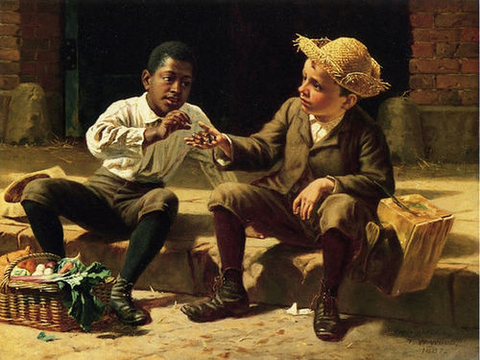

Slide 14
Naturalism - Characteristics
Themes
  Survival (man against nature, man against himself)
  Determinism (nature as an indifferent force on the lives of human beings)
  Violence

Slide 15
Regionalism
Regionalism is all about “local flavor” or “local color.”
“Local Color” means a reliance on minor details and dialects.
They usually wrote about the South or the West.
More often than not, these stories were full of humor and small-town characters.
Mov’t | π

Slide 16
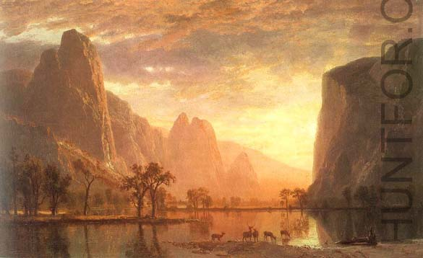
Notes:
romanticism

Slide 17
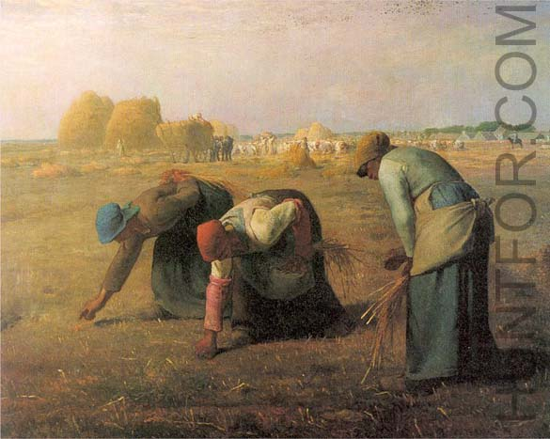
Notes:
Jean-François Millet (millet1.jpg) Painting :The Gleaners

Slide 18
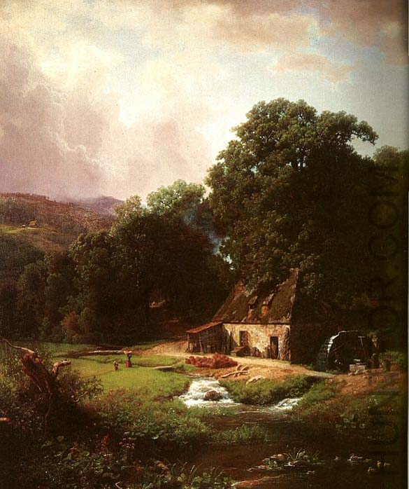

Slide 19
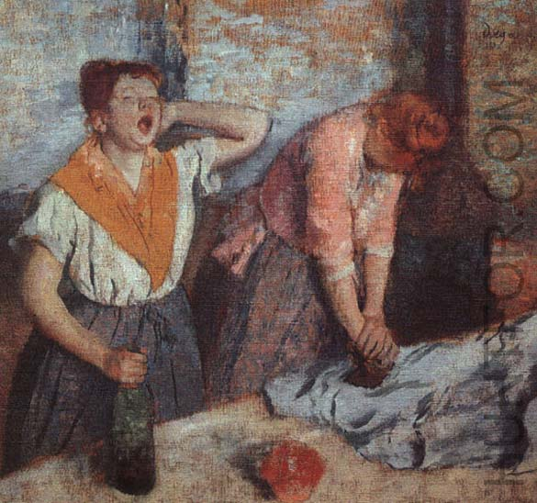
Notes:
Edgar Degas
Women Ironing

Slide 20
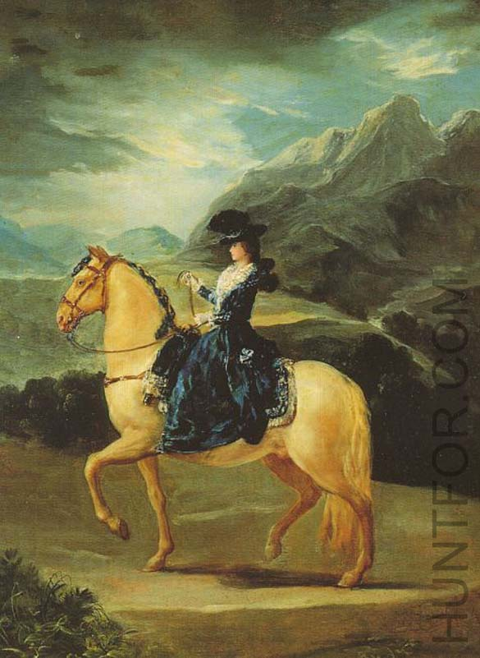

Slide 21
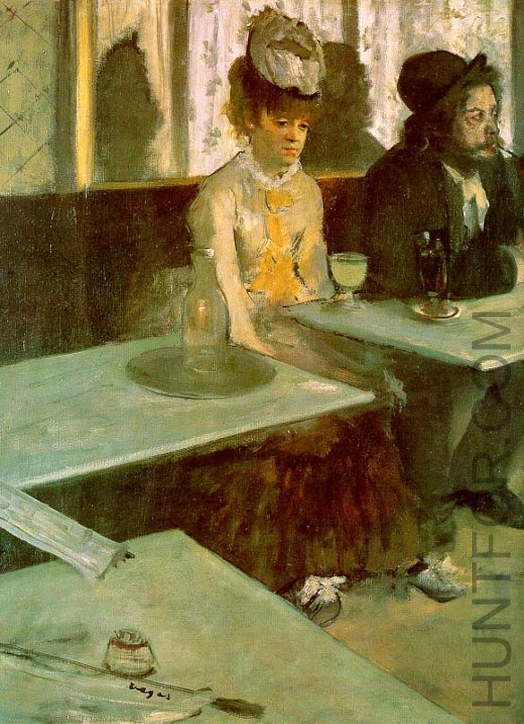
Notes:
In a Cafe (The Absinthe Drinker)
Edgar Degas

Slide 22
The Culture of the Time:

Slide 23
Historical Context
Population of the United States is growing rapidly. (1865 -1915)
Science, industry and transportation are expanding.
Literature also was growing, but most new writers were not Romantics or Transcendentalists. They are Realists.
The “Frontier” did not exist as before; its legacy changed and impacted Realists in its new form.
The aftermath of the Civil War meant that Americans were less certain and optimistic about the future.
The idealism of the Romantics and philosophy of Transcendentalists seemed out of date and irrelevant to many readers.

Slide 24
Slavery
Slavery was a reality throughout America since it was founded, despite the hot debate as to whether or not we should have slaves.
The issue hinged on two different Americas: The Urban, Industrial North and the Agrarian South.
π

Slide 25
The American Civil War
“The War Between the States”
“The Nefarious War of Northern Aggression”
“The Scuffle of Southern Secession”
π

Slide 26
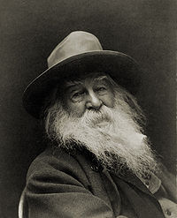
The Civil War
A nation divided
Interrupts Transcendentalism
Walt Whitman
  Transition writer: late Transcendental poet, early Realist
  Leaves of Grass
  “O Captain, My Captain”

Slide 27
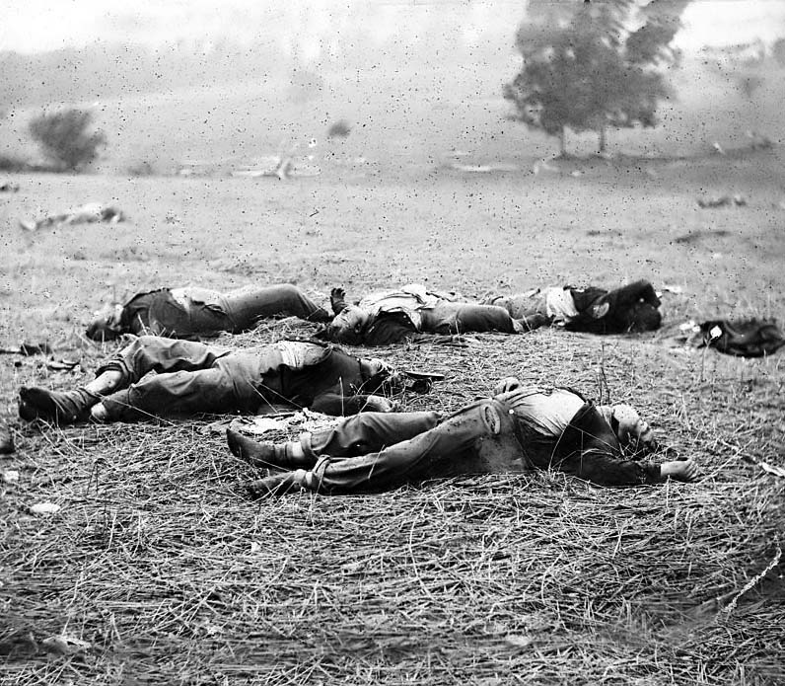

Slide 28
How did this literary movement prevail?
The Industrial Revolution
  economic, social, and political changes that took place in post-war life allowed American Realism to succeed

Slide 29
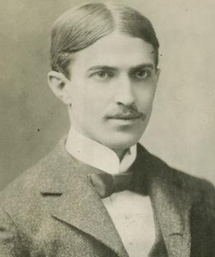
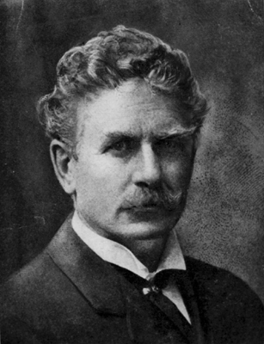
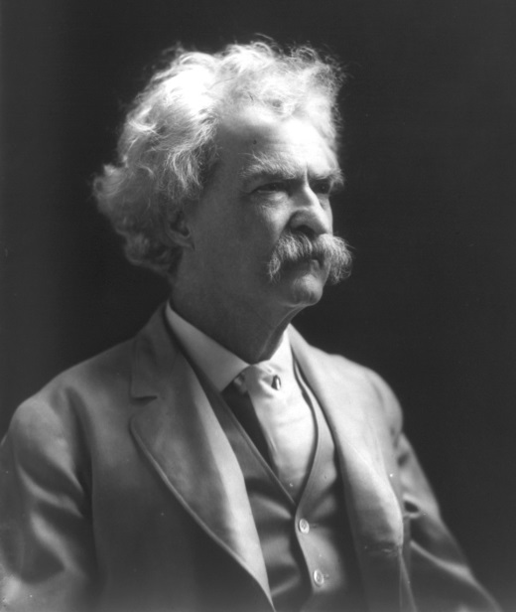
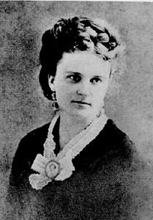
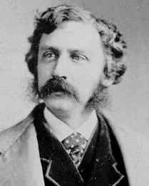
Authors
Stephen Crane
Ambrose Bierce
Mark Twain
Jack London
Kate Chopin
Bret Harte
π

Slide 30
Realism is nothing more and nothing less than the truthful treatment of material.
William Dean Howells

